Slide 1
Exception
Handling

Slide 2
Uncaught Exceptions
When the Java runtime detects an exception, it constructs an object and throws the exception.
If there are no exception handlers in the program, the exception is caught by the default exception handler.
User defined catch using catch keyword.
Finally keyword.

Slide 3
Example
package class1;
public class test {
public static void main(String args[]) {
int b = 30,c = 0;
System.out.println(b/c);
}
}
Console:
Exception in thread "main" java.lang.ArithmeticException: / by zero
at class1.test.main(test.java:5)

Slide 4
try and catch
public class Testtrycatch2{
public static void main(String args[]){
try{
int data=50/0;
}catch(ArithmeticException e)
{System.out.println(e);}
System.out.println("rest of the code...");
}
}
Console:
Exception in thread "main" java.lang.ArithmeticException: / by zero
rest of the code...

Slide 5
try catch finally
class TryCatchFinallyExample {
public static void main (String[] args){
int[] arr = new int[4];
try {
int i = arr[4];
// this statement will never execute
// as exception is raised by above statement
System.out.println("Inside try block"); }
catch(ArrayIndexOutOfBoundsException ex){
System.out.println("Exception caught in catch block"); }
finally
{
System.out.println("finally block executed");
}
// rest program will be executed
System.out.println("Outside try-catch-finally clause");
}
}

Slide 6
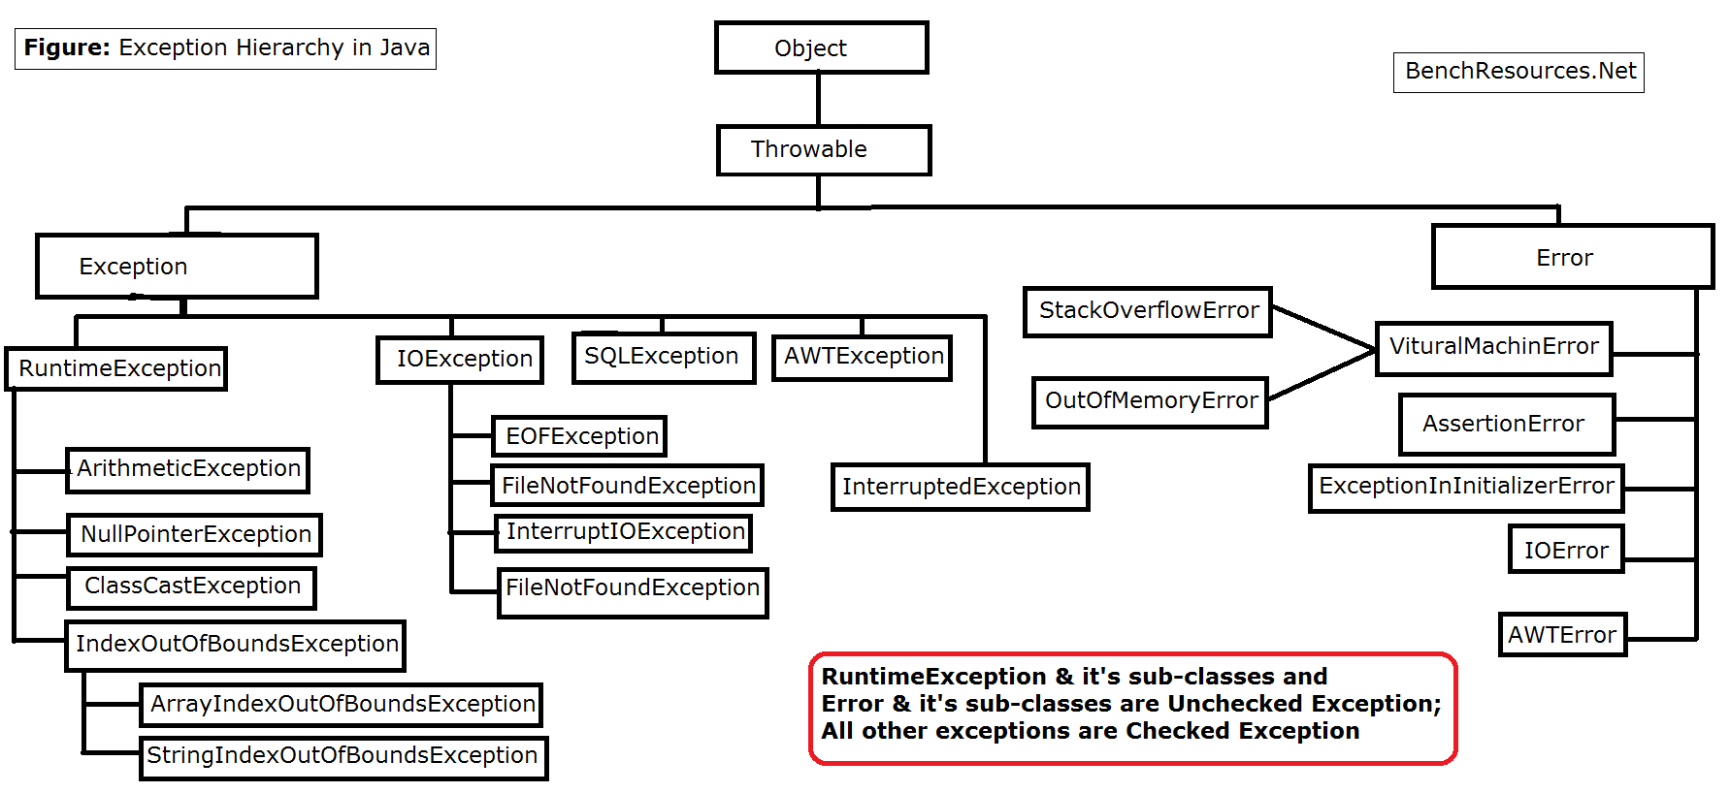

Slide 7
Key Concepts
Displaying an exception
Throwable overrides the toString(), and
the exception object can be passed to println() and
the description of the exception gets printed.

Slide 8
Multiple try-catch
public class TestMultipleCatchBlock{
public static void main(String args[]){
try{
int a[]=new int[5];
a[5]=30/0; }
catch(ArithmeticException e){System.out.println("task1 is completed");}
catch(ArrayIndexOutOfBoundsException e){System.out.println("task 2 completed");}
catch(Exception e){System.out.println("common task completed");}
System.out.println("rest of the code...");
}
}

Slide 9
class TestExceptionPropagation1{
void m(){ int data=50/0; }
void n(){ m(); }
void p(){
try{ n();
}catch(Exception e){System.out.println("exception handled");} }
public static void main(String args[]){
TestExceptionPropagation1 obj=new TestExceptionPropagation1();
obj.p();
System.out.println("normal flow...");
}
}

Slide 10
Memory Stack
Exception Occurred
m( )
No Exception handling provided
Exception thrown to the calling method
n( )
No Exception handling provided
Exception thrown to the calling method
p( )
Exception handling provided
main( )

Slide 11
Exceptions
try
catch
finally
throw
throws

Slide 12
Key Concepts
‘throw’ keyword is used to throw an exception explicitly.
But object thrown should be of type Throwable or subclass of throwable. Primitive types such as int, char … and non throwable classes like String cannot be used.
Many built in runtime exceptions have at least two constructors, one that takes a string parameter describing the exception and one no argument constructor.
e.getMessage() can also be used.

Slide 13
Throw
public class TestThrow1{
static void validate(int age){
if(age<18)
throw new ArithmeticException("not valid");
else
System.out.println("welcome to vote");
}
public static void main(String args[]){
validate(13);
System.out.println("rest of the code...");
}
}

Slide 14
Key Concepts
‘throws’ keyword is used to specify the callers of the method, when it is capable of causing an exception and it does not handle.

Slide 15
Throws
import java.io.IOException;
class Testthrows1{
void m()throws IOException{
throw new IOException("device error");//checked exception
}
void n()throws IOException{ m(); }
void p(){
try{ n();
}catch(Exception e){System.out.println("exception handled");} }
public static void main(String args[]){
Testthrows1 obj=new Testthrows1();
obj.p();
System.out.println("normal flow...");
} }

Slide 16
import java.io.IOException;
class Testthrows1{ void m() {
throw new IOException("device error");//checked exception }
void n()throws IOException{ m(); }
void p(){ try{ n();
}catch(Exception e){System.out.println("exception handled");} }
public static void main(String args[]){
Testthrows1 obj=new Testthrows1();
obj.p();
System.out.println("normal flow...");
}
}

Slide 17
Throw vs throws
throw | throws
Java throw keyword is used to explicitly throw an exception. | Java throws keyword is used to declare an exception.
Throw is followed by an instance. | Throws is followed by class.
Throw is used within the method. | Throws is used within the method signature
You cannot throw multiple exceptions. | You can declare multiple exceptions. e.g. public void method() throws IOException, SQLException

Slide 18
User Defined Exception
Helps the user to create their own exception for situations specific to the applications.
The user defined exception class is derived from the Exception class
Exception class does not have methods on its own. But it inherits methods provided by the Throwable class.
Overriding the toString() method helps to provide a description about the exception.

Slide 19
Chained Exceptions
Allows to associate another exception with an exception.
The second exception describes the cause of the first exception.
Chained exception methods supported by Throwable are getCause() and initCause()

Slide 20
Exception - Example
class test{
public static void main(String args[]) {
try{
NumberFormatException e =new NumberFormatException("Outer");
e.initCause(new ArithmeticException("Inner"));
throw e;
}
catch(NumberFormatException e) {
System.out.println(e);
System.out.println(e.getCause());
}
}
}

Slide 21
Difference between C++ and JAVA
In C++, all types (including primitive and pointer) can be thrown as exception. But in Java only throwable objects (Throwable objects are instances of any subclass of the Throwable class) can be thrown as exception.
In C++, there is a special catch called “catch all” that can catch all kind of exceptions. In Java, we can catch Exception object to catch all kind of exceptions.
In Java, there is a block called finally that is always executed after the try-catch block. This block can be used to do cleanup work.
In C++, all exceptions are unchecked. In Java, there are two types of exceptions – checked and unchecked.
In Java, a new keyword throws is used to list exceptions that can be thrown by a function. In C++, there is no throws keyword, the same keyword throw is used for this purpose also.

